Slide 1
Smart Traffic System
Project Guide:
Mrs Manasa vavilapalli
-121710318057(Mahesh)
-121710318055(Sai Rao)
-121710318039(Dharmesh)
-121710318013(Dinesh)

Slide 2
Abstract:
Nowadays, Machine learning is developing very fastly. Almost in every sector machine learning is used. And it is an application of artificial intelligence where available information is used through algorithms to process or assist the processing of statistical data. While Machine Learning involves concepts of automation, it requires human guidance.
The proposed project is on Mask detection. Here we used Convolutional neural networks(CNN) and for Simulation purpose here we used Simulation of urban mobility(SUMO).

Slide 3
Problem Statement:
In our indian roads, the major problem is traffic due to heavy population. Especially in metropolitan cities the roads are always busy and It is creating major trouble day by day, in some cities it takes hours to clear the traffic. And this happens when there are more number of vehicles in the city and weak traffic management system. Due to this problem sometimes ambulances and fire engines will get stuck in the traffic.
We can solve this problem using Machine learning and we have created Smart Traffic System. And we can implement this System into our indian traffic management system.

Slide 4
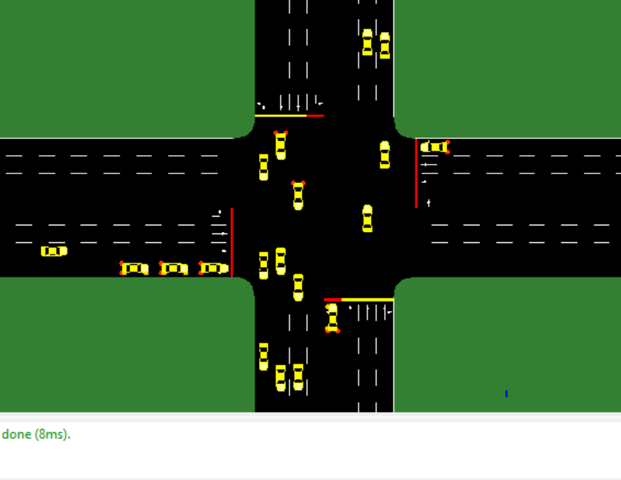
Firstly to implement the this system we need to observe the situation of the road. Here we constructed two matrices
-The first matrices divides the road into 16 segments and 7 meters each and checks whether the car is in the segment or not. Here the segment is nothing but the lane. Totally we took 4 roads. For each road we took 4 lanes.

Slide 5
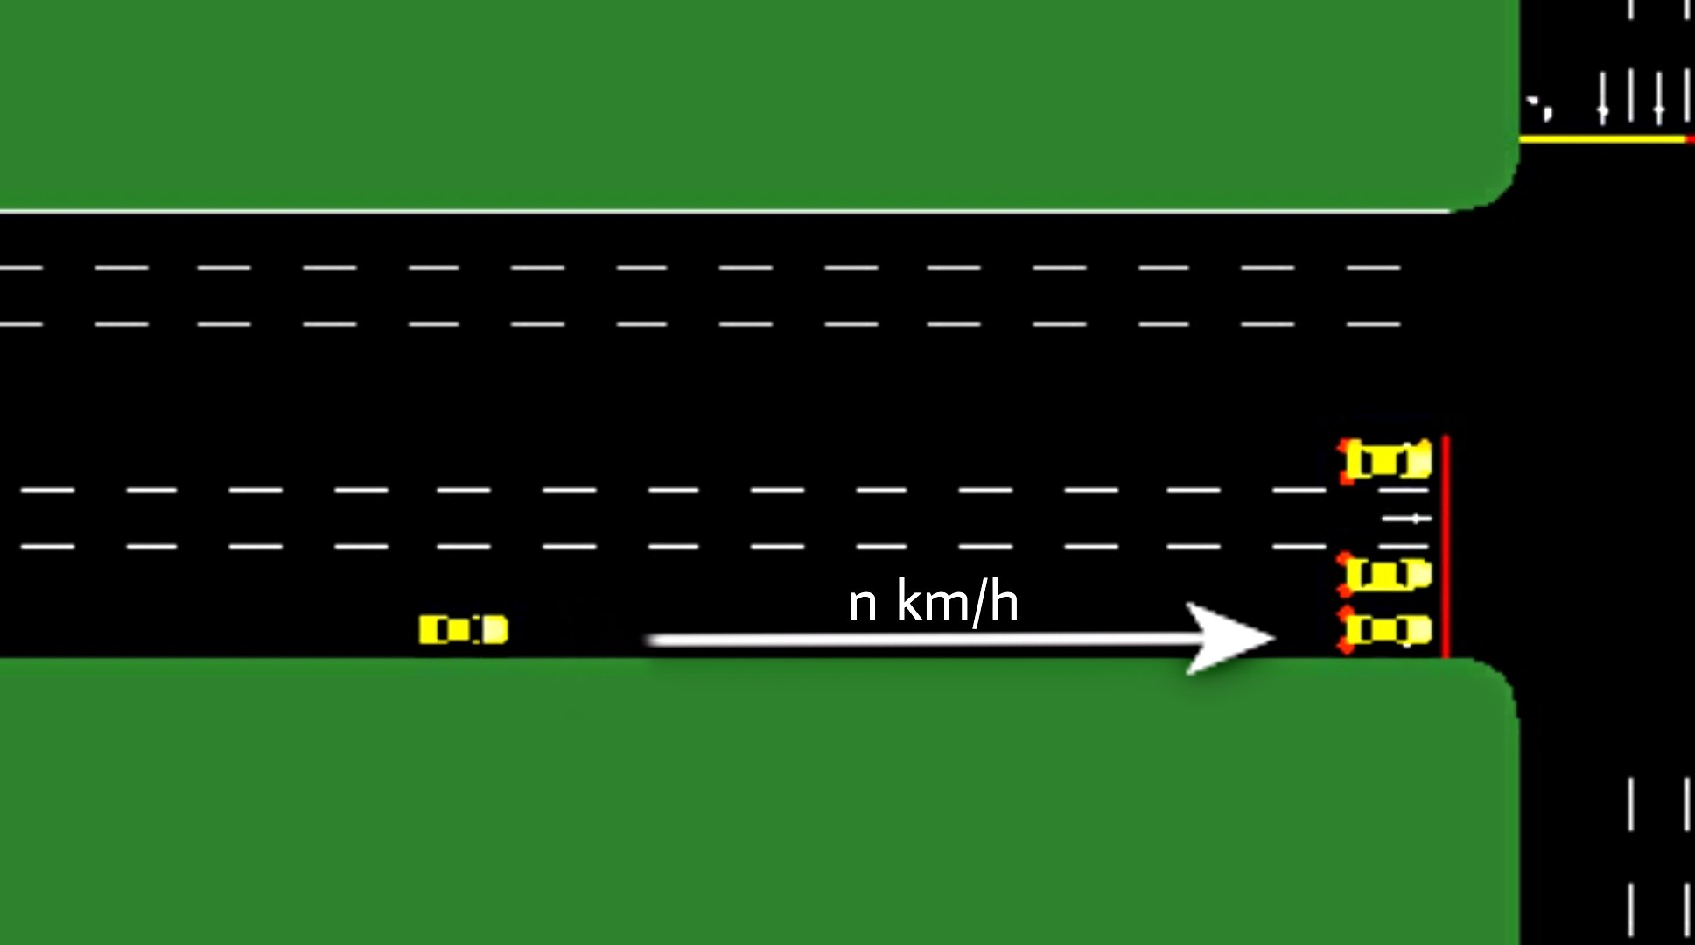
-After checking the th cars in the first matrix it now comes to the second matrix. This matrix is very important. This matrix checks the speed of the car which is coming towards the Traffic Junction. As it calculates the time taken to reach the traffic junction

Slide 6
Simulation:
For simulation purpose here we used Simulation of urban mobility(SUMO). It is an open Source software which is used to handle Traffic system. It is portable,highly microscopic and we can include several packages which not only shows the cars movement but also shows pedestrians and many set of tools for scenario creation.
This scenario brings the real world feel and experience the traffic in the screen. In the last two slides you can the see the snapshots of the Sumo simulator

Slide 7
Sumo can be imported using (sumolib). It is the python module which is used to work with sumo networks and Xml files.
In Sumo we have visualization tools which is used to visualize a wide range of simulation tools in a graphical and friendly way.
Using xml tools we can convert the outputs generated by sumo to CSV/Spreadsheets.

Slide 8
In this System we used CNN-DQN
Since the nature of DQN is very unstable, two methods were used to stabilize its convergence. Firstly, Replay Memory was implemented, which stores past actions and allows to use training in batches over them.
The second thing is the concept of a target Q-network. It allows not to chase the "moving target" while training by initializing two networks with the same weights. While optimizing, the weights of target network are kept as they are and updated only after N iterations.

Slide 9
Two models, namely convolutional and fully-connected ones are trained, both with 1600 epochs, 4500 steps each.
Those models were trained on CPU and it took around 24 hours for each of them.
And for testing purposes three scenarios were generated with 800, 1300, 1800 cars. They represent three possible states of the road during low load, mid and peak-hour accordingly. The results for each are presented in the table in the next slide

Slide 10
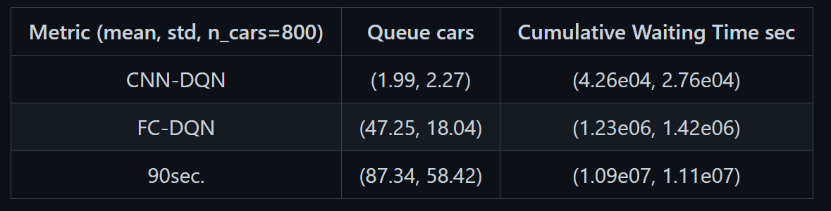
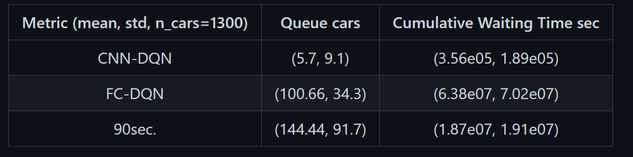
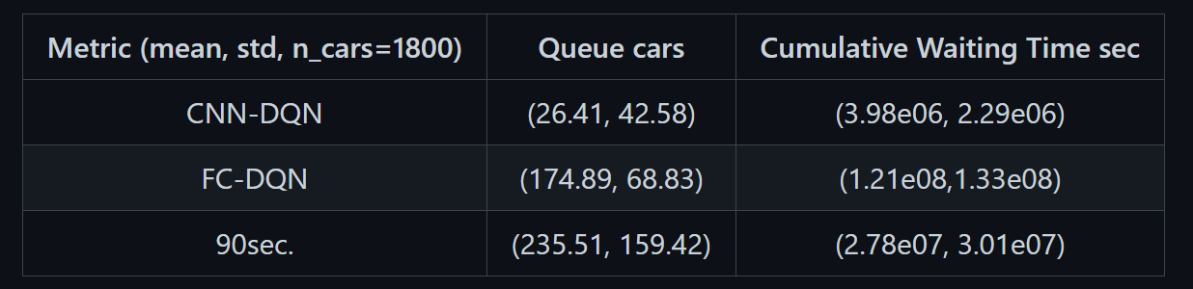

Slide 11
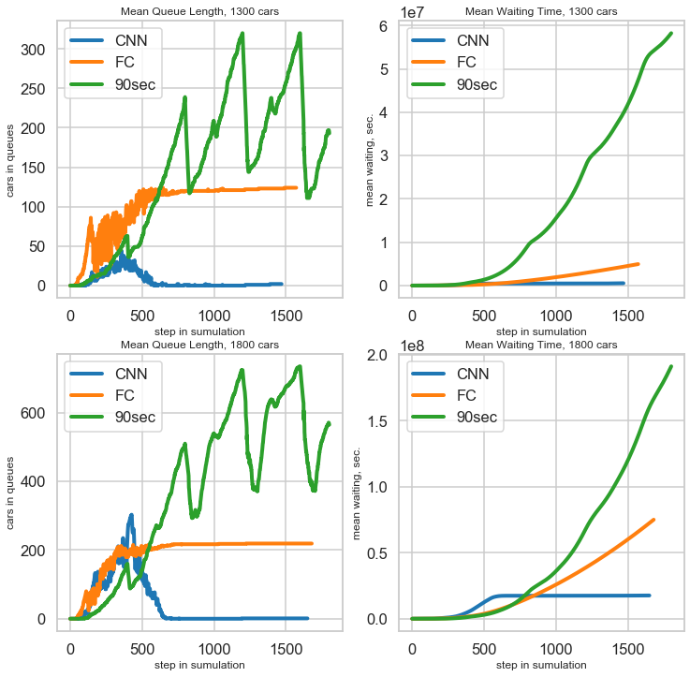
Here You can observe the graph CNN-DQN is best in the traffic system.
While FC(fully connected) and 90 sec cycle produces more waiting time and also length of the traffic will be more.
When the load is at peak, on average 117 seconds a vehicle waits in the que (CNN). That is 20% better than a steady 90 sec cycle. As it can be seen, FC-DQN cannot manage medium road load, however CNN-DQN manages to operate with high load with no problem.

